Slide 1


DATA ANAYSIS
MADHURI RAO

Slide 2

Data Analytics in Business
Data analytics in business describes collecting, processing, analyzing, and interpreting vast volumes of data, extracting meaningful insights, trends, and patterns that can guide and inform strategic decisions, improve operational efficiency, and foster overall business growth

Slide 3
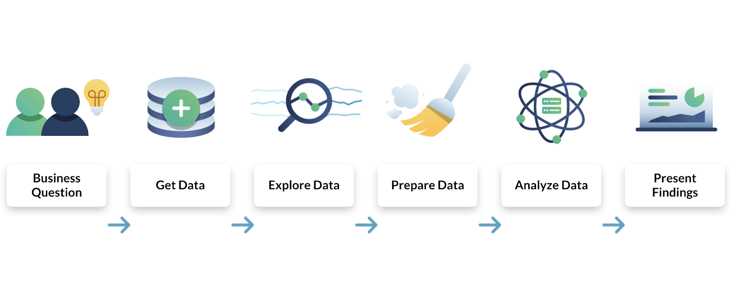
Dynamic delivery

Slide 4
How Do You Conduct Business Analytics
Data Collection. Collecting relevant data from different sources, which includes marketing campaigns, customer interactions, operational processes, sales transactions, and external market data.
Data Processing. Cleaning, organizing, and preparing the collected data for analysis to ensure its accuracy and consistency.
Data Analysis. Applying mathematical, statistical, and machine learning techniques to discover correlations, patterns, and insights within the processed data.
Data Interpretation. Interpreting the data analysis results in deriving actionable insights and conclusions that can improve the likelihood of better decision-making.
Decision Making. Employing the insights from data analysis to make informed decisions that will impact different areas of the organization, such as marketing strategies, resource allocation, product development, etc.
Continuous Improvement. Monitoring and evaluating decision outcomes based on data analytics, then refining and adjusting the strategies over time-based on subsequently obtained data and insights.

Slide 5
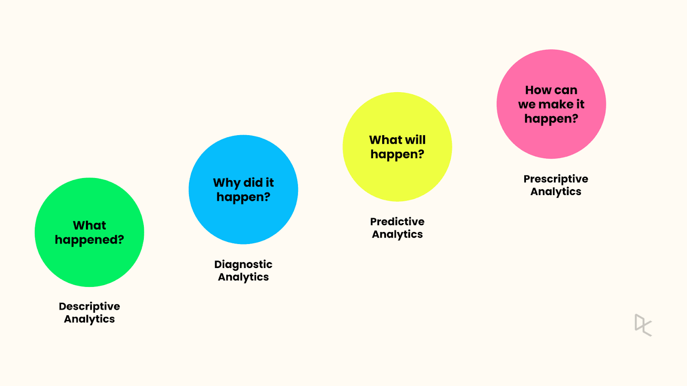
The Four Types of Data Analytics
Descriptive Analytics (“What has happened?”)
Diagnostic Analytics (“Why did this happen?”)
Predictive Analytics (“What will happen in the future?”)
Prescriptive Analytics (“What should we do?”)

Slide 6

Advantages of Data Analytics in Business
Improving efficiency.
Making better decisions.
Reducing costs.
Increasing revenue
Making the business more competitive.

Slide 7
Data Analytics Improve Business Management?
Customer insights. Data analytics offers a deeper understanding of customer behavior, buying patterns, and preferences, allowing businesses to tailor products and services to the consumers’ needs.
Competitive advantage. Leveraging data analytics gives businesses a competitive edge by staying current on market trends, responding quickly to changes, and outperforming their competitors.
Informed decision-making. Data analytics lets businesses strategically use real-time insights and trends, reducing reliance on guesswork, hunches, and intuition.
Identifying hidden opportunities. Organizations can discover otherwise hidden opportunities, emerging trends, and market gaps by analyzing large datasets, letting them acquire new revenue streams.
Operational efficiency. Businesses can use data analytics to optimize processes and workflows, identifying inefficiencies, bottlenecks, and areas for improvement.

Slide 8
Data Analytics Improve Business Management?
Performance tracking. Businesses can monitor their key performance indicators (KPIs) via data analytics, letting them measure success, identify improvement areas, and adapt strategies as necessary.
Personalized marketing. A company can develop customized marketing campaigns that jibe with individual preferences by analyzing customer data, leading to higher engagement and conversion rates.
Predictive insights. Data analytics lets businesses predict future trends and outcomes, which can improve long-term planning and strategy development.
Resource allocation. Businesses can use data to assign resources more effectively, understanding which initiatives yield the best returns, thus ensuring optimal resource utilization.
Risk management. Data analytics helps identify risks and vulnerabilities by analyzing historical data, allowing organizations to introduce proactive risk mitigation strategies.

Slide 9
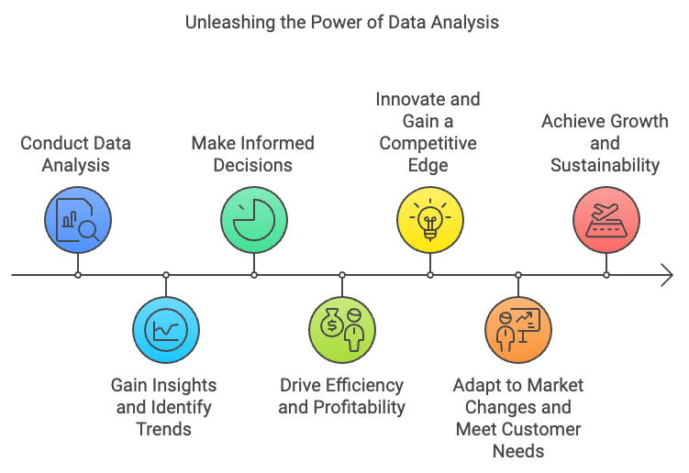
Speaking engagement metrics

Slide 10
Thank you
MADHURI RAO
EDIFYBYMADHURIRAO

